Slide 1


More Evidence on Income Distribution and Growth

By George R. Clarke
Presented by Yuanchang Zhang

Slide 2


Introduction

Inequality is necessary for capital accumulation, and therefore contains the seeds of eventual increases in everyone’s income. (Adelman & Robinson, 1989)
  Allow the rich to accumulate wealth faster
  Redistribute to make everyone wealthier
Inequality slows down growth. (Alesina & Rodrik, 1991)
  Greater conflict over distributional issues
  More government intervention and higher taxes

Slide 3
Introduction

Properties of the inequality data
Cross country growth regressions
  Inequality and growth are negatively correlated
  This correlation does not depend on political regime – democracy or not

Slide 4
Properties of the Inequality Data

Measures of Inequality
“The Ratio”
Gini Coefficient
Coefficient of Variation
Theils’ Index

Slide 5
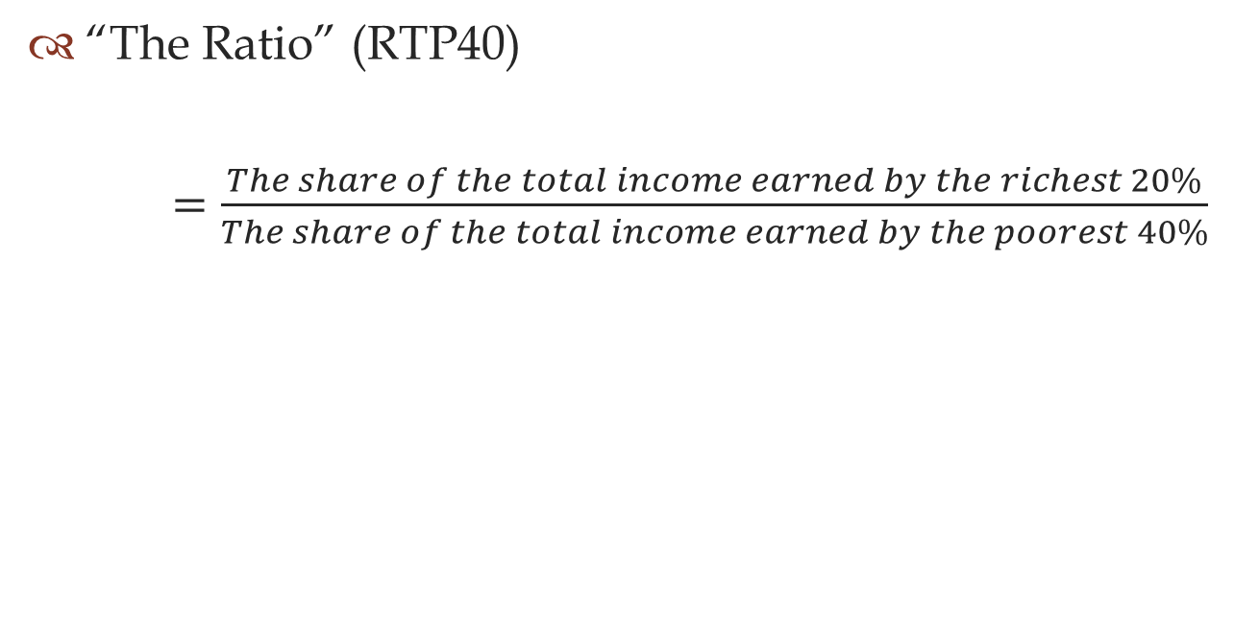
Measures of Inequality


Slide 6
Measures of Inequality

Gini Coefficient (GINI)
  Developed by Corrado Gini in 1912
  Derived from the Lorenz Curve

Slide 7
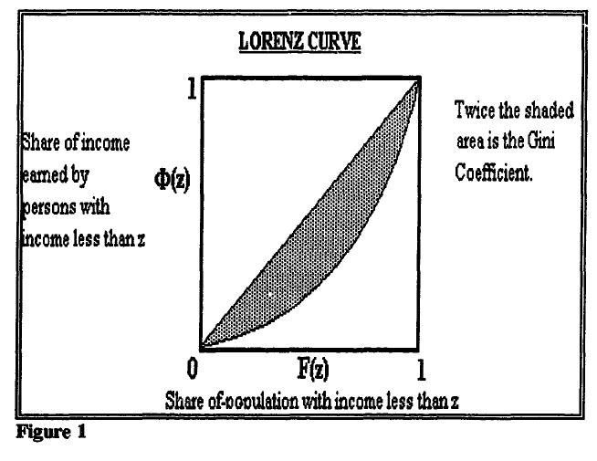

Slide 8

Measures of Inequality

Coefficient of Variation (COEFFVAR)
  Problem of variance
    Multiply everyone’s income by n, the variance will change by n square
  Divide the square root of variance by the mean income

Slide 9
Measures of Inequality

Theils’ Index (THEIL)
  Derived from the entropy of a system in information theory: the maximum possible entropy of the data – the observed data
where s_{i} is person i’s share of total income.
  When s_{i} = 1/n, the entropy is maximized, indicating the perfect equality

Slide 10
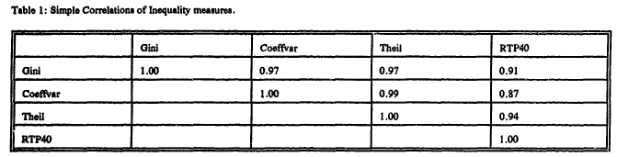
Properties of the Inequality Data

Different measures give different values and even different ordering for countries
For all measures, as inequality increases the value of the measure increases
They are highly correlated

Slide 11
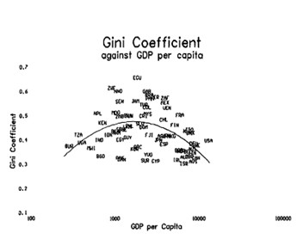
Kuznets’ Inverted-U Shape

Cross-country data on inequality follows Kuznets’ inverted-U shape
Driven by the high negative correlation between inequality and wealth among developed countries

Slide 12
Cross Country Growth Regressions

The base regression: “Barro type” growth regression
  LGPC7088 = β₀ + β₁ SGDPPC70 + β₂ REVC7085 + β₃ASSP7085 + β₄PPI70DVN + β₅CPRIM60 + β₆CSEC60 + β₇SGOV7088 + β₈IV + ε
  LGPC7088: the least squares growth of rate of GDP per capita
  SGDPPC70: the initial GDP per capita in constant dollars
  REVC7085: the average number of revolutions and coups per year between 1970 and 1985

Slide 13
Cross Country Growth Regressions

  LGPC7088 = β₀ + β₁ SGDPPC70 + β₂ REVC7085 + β₃ASSP7085 + β₄PPI70DVN + β₅CPRIM60 + β₆CSEC60 + β₇SGOV7088 + β₈IV + ε
  ASSP7085: the number of assassinations per million population per year
  PPI70DVN: the deviation of the price level for investment in 1970 from the sample mean
  CPRIM60 & CSEC60: primary and secondary enrollment rates lagged ten years
  SGOV7088: average government share of GDP
  IV: inequality variables

Slide 14
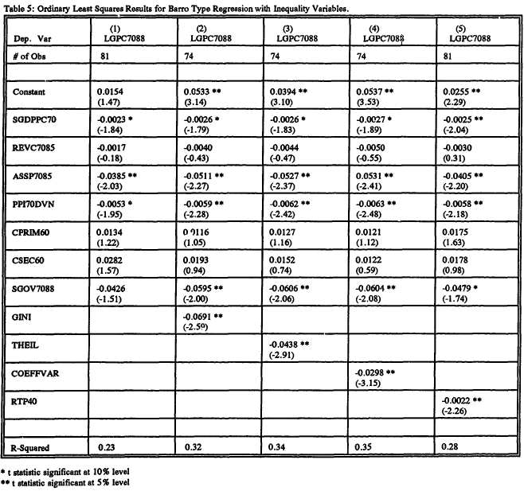

Slide 15
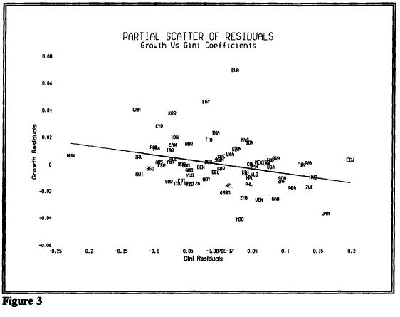
Concerns - Outliers


Slide 16
Concerns - Heteroskedasticity

Breusch-Pagan test & Goldfeld Quandt test
Correct for heteroskedasticity
  OLS with Whites’ heteroskedastic consistent standard errors
  Weighted least squares weighting by [(1/GDP per capita) squared]
In both cases, the coefficients on all inequality variables remain significantly negative at conventional significance levels.

Slide 17
Concerns - Endogeneity

Poor quality of inequality data: different sources, different units, and different years
Two Stage Least Squares regression:
  In addition to the Barro regressors, the following instruments are used: a dummy for socialist economies, a dummy for African countries, a dummy for Latin American countries, log of initial per capita GDP and squared log of initial per capita GDP
The coefficients on inequality variables are slightly more negative, and remain significant at 5% level

Slide 18
Extended Regression

Additional Variables:
  Trade share of GDP averaged over 1970 to 1988
  Money and quasimoney as share of GDP averaged over 1970 to 1988
  The standard deviation of inflation over the period 1970 to 1988
  The average of the ratio of claims on the private sector by the casualties between 1970 to 1988
The sign and significance of the coefficients remain the same

Slide 19
Political Regime and Inequality

Add an interaction term into the base regression:
  LGPC7088 = β₀ + β₁ SGDPPC70 + β₂ REVC7085 + β₃ASSP7085 + β₄PPI70DVN + β₅CPRIM60 + β₆CSEC60 + β₇SGOV7088 + β₈IM + β₉IV*DEM + ε
  DEM: a dummy variable that is one if the country is democracy and zero if it is non-democracy

Slide 20
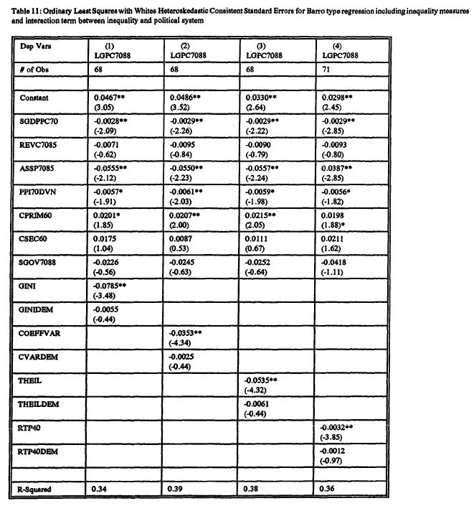

Slide 21
Conclusion

The cross country data on inequality follows Kuznets’ inverted U shape
Inequality is negatively, and robustly, correlated with growth
The correlation between inequality and growth is not dependent upon whether the government is a democracy or a non-democracy

Slide 22
Conclusion

Notice: although inequality is negatively correlated with growth, this does not necessarily imply that “soak-the-rich” policies will improve long-term growth
  The direction of causality has not been determined and the effects of specific income distribution policies have not been tested
  The cost of government intervention may outweigh the benefits of greater equality
For certain: inequality is NOT a prerequisite for growth

